Slide 1


SixSafety:
Empowering You and Your Community’s Safety
Toronto Police Service
Major Crime Indicators Open Data
November 25, 2024
MMAI 5040 - Section U
Allan Galli Francis (216359069)
Bailie Geddes (220856316)
Christine Tang (214151401)
Ethan Hu (221362249)
Numan Ekrekli (212727053)
Zachary Kulik (217128158)
“The work we submitted as part of this assignment is original, and due credit is given to others where appropriate. We accept and acknowledge that that each member of our team is equally responsible for if the assignment found to be plagiarized in any way, and we will be subject to school’s Academic Integrity policy”

Slide 2



Agenda
1. Business Problem
2. Introduction, Background & Context
3. Modelling Approach and Analysis
4. Key Findings
5. Conclusion
6. Next Steps

Slide 3
Executive Summary
BUSINESS PROBLEM
KEY OBJECTIVES
The Toronto Police Service faces challenges in allocating limited resources amid rising crime rates, budget constraints and public scrutiny.
While technology may enhance public safety, community involvement remains crucial for success.
1
Increase Community Safety and Engagement
2
Optimize Crime Prevention and Resource Efficiency
3
Develop Crime Risk Index
4
Build and Enhance Safety Recommendation Engine
SOLUTION
RECOMMENDATIONS
SixSafety is a data-driven tool leveraging the Toronto Major Crime Indicator (MCI) dataset to categorize neighbourhoods by crime risk, delivering safety recommendations to the Toronto public. This empowers people to take proactive safety measures.
Launch a SixSafety pilot in high-crime neighbourhoods with TPS staff training and community engagement.
Use partnerships, instructional sessions, and social media to inform and involve residents.
Create feedback loops and audits to ensure accuracy, fairness, and ongoing improvements.

Slide 4
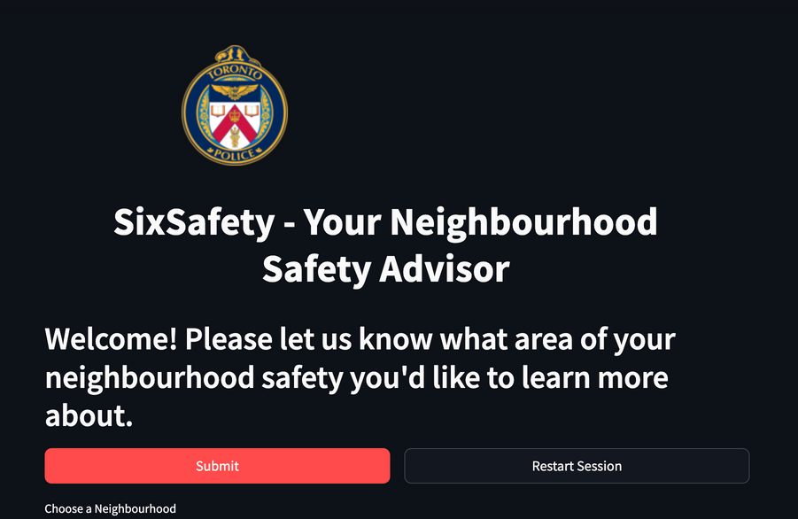

Introduction
SixSafety focuses on leveraging Toronto’s Major Crime Indicator (MCI) dataset to:
Develop a risk categorization system (severity by crime group).
Identify patterns and crime trends to help increase resource efficiency.
As TPS faces budget scrutiny and rising crime rates, the need for effective resource allocation is increasing.
Key Objectives:
1. Increase Community Engagement
Business
Empower people, boost community engagement, align with SafeTO Plan's Goal #5.1 (Community Engagement)
2. Reduce Crime and Improve Efficiency
Business
Increased safety measure adoption may lead to improved outcomes, like fewer non-urgent calls, simplified investigation processes, better resource allocation, etc.
3. Develop Risk Index and Measure Safety Impact
Analytical
How can MCI data categorize neighbourhoods by crime risk?
How could user adoption of safety plans reduce major crime rates?
4. Build a Safety Recommendation Engine
Analytical
How can we iteratively fine-tune an LLM and safety knowledge base?
What metrics could support Toronto Police Services’ goals, and demonstrate community engagement and safety?

Slide 5



Background
RESOURCE CONSTRAINTS
TECHNOLOGICAL CONSTRAINTS
COMUNITY TRUST
The Toronto Police Service’s 2024 budget is $1.18 billion, but a $1.8 billion citywide deficit intensifies pressure for efficient resource allocation.
Effective deployment is critical as scrutiny over public spending grows.
Advances in AI offer opportunities for crime reduction and faster response times, with studies suggesting a potential 30-40% decrease in crime and up to 35% faster response times.
However, ethical and privacy concerns, such as past issues with ClearView AI, require careful consideration.
Trust in policing varies across demographics, with younger and minority communities expressing more skepticism.
Rising crime rates and public expectations for transparency emphasize the importance of community engagement in public safety initiatives.
Toronto Police must address challenges of resource constraints and varying levels of public trust.

Slide 6


Introducing SixSafety
3
Reliable Sources
2
4
Personalization
Curation
Benefits Both
Toronto Police Service
General Public in Toronto
1
5
Risk Analysis
Safety Plan
SixSafety, an AI-powered platform designed to provide reliable and personalized safety recommendation plans.
Time for a
Sneak Peek!
Try it Yourself!

Slide 7

User Journey
1
2
3
Accessing the App
Accessing the App
Receiving Crime Information
Follow-Up Questions
Name: Alex
Location:
West Humber-Clairville (recently moved here)
User-friendly GUI
Alex enters his neighbourhood information
App displays crime severity scores, and asks for his crime focus area.
App asks up to 3 follow-up questions to clarify what Alex is looking for
Concern:
Worried about protecting against Break & Enters.
4
5
Backend Processing
Safety Plan Output
Relevant documents are retrieved, and the LLM brainstorms how to help Alex with this information
Generated safety plan, tailored to Alex’s information, answering his concerns
Objective:
Learn about recommended safety measures for home security for his family.
6
Outcome:
Alex feels informed and prepared; he takes the recommended steps, like installing better locks and connecting with his Neighbourhood Watch program.

Slide 8
Modeling Preprocessing & Exploratory Analysis
Major Crime Indicators:
Data cleaned, deduped, and grouped by neighbourhood and crime group.
Data normalized:
Raw crime numbers converted to per capita by merging with neighbourhood-level population data.
Severity Scores Calculated:
Per neighbourhood and crime group, average crime per capita is calculated.
Severity scores are set to Low, Medium, or High based on how far away the neighbourhood/crime combination is from the average in either direction.
Data Pre-processing
Crime Varies by Neighbourhood
Exploratory analysis showed that crime total varies significantly by neighbourhood and other factors. This informed decision to normalize occurrences by neighbourhood population.
Need for Personalization
Exploratory analysis highlighted importance of enhancing community engagement, by simplifying access to crime prevention resources and personalizing recommendations to individual user needs.
Discoveries / Takeaways

Slide 9



Modeling The Build
FRONT-END
BACK-END
OUTPUT
SixSafety User Survey
Safety Plan Generation
Safety Plan
Streamlit-based interface for user input
User is asked to enter their information:
Neighbourhood
Crime-type area(s) to focus on based on severity score.
Max. 3 questions to gain clarity
Agentic framework is used - two LLM agents working together
Agent #1: Generates interface and multiple-choice questions, giving information to Agent #2.
Agent #2: Uses this information to think and exchange questions with user.
Process survey data and retrieves relevant information (Information Retrieval)
Chain of Thought Reasoning:
#1: LLM brainstorms how survey results and documents could help generate a plan
#2: Synthesizes all information to create safety plan.
Neighbourhood-Specific Assessment
Targeted Safety Recommendations
Personal Safety Protocol
Preventive Measures
Useful Resources (i.e. Toronto Police articles, guides)
Our approach directly transforms user input into tailored, actionable safety plans, empowering residents and enabling public safety.

Slide 10



Modeling Evaluation
Metric Evaluation
Model Limitations
Responsible AI
Information Retrieval:
90%+ Context Precision (document relevancy); used prompt-engineering to improve Context Recall (coverage of recommendations) after 2 iterations (70%)
Quality of Safety Plan:
Strong scores for factual accuracy (Faithfulness) and Answer Relevancy
Human-in-the-loop:
Quality and evaluation checks on ~40 safety plans, finding common themes of issues (i.e. formats)
Knowledge Gaps: Plan quality improves with domain expert input on documents
Prioritizing Precision Over Recall: Build trust by providing relevant documents; trade-off of missing some information about crimes or areas
Cost: $0.21 CAD per plan, ~1 minute latency.
There are future opportunities to optimize
LLM Hallucination: Incorrect output will affect plan quality. Improved prompting and retrieval techniques may reduce issues
Credible Sources: Trusted sources used (i.e. City of Toronto, Toronto Police, TTC)
Output Transparency: Each plan cites 5 sources, enabling traceability
LLM Guardrails: Defined format and parameters to reduce hallucination and prevent abuse (i.e. multiple-choice inputs)
Bias Mitigation: Human in the Loop reviews, ensuring safety plan focuses on actionable plans without bias on demographic factors

Slide 11
Conclusions
Efficient Resource Allocation
Supports Toronto Police Service (TPS)’s $100 million Cost Avoidance Strategy; potentially reduce number of non-urgent calls, optimizing resource allocation to enhance public safety (2023 Program Summary Toronto Police Service).
Leveraging Technology and Digitalization
TPS budget study found 91% of respondents recognized the importance of digitization tools like online reporting; SixSafety complements Toronto Police’s journey towards digitization (“2024 Budget- Toronto Police Service.”, 2023).
Encouraging Community Contribution
Support existing community engagement programs, like Neighbourhood Community Office program. This supports TPS’ mission: creating safer neighbourhoods by helping citizens make informed decisions about safety.
Building Trust and Individualized Experience
Displaying crime severity scores fosters transparency and trust between the community and TPS. Providing crime prevention information also builds trust, incorporating community feedback over time.
Notes:
Helloo

Slide 12
Next Steps
1
Collaboration and Improvement
2
Pilot Tests and Community Engagement
3
Continuous Improvement
and Scaling
Partner with TPS and domain experts to test tool, evaluate and create good examples of safety plans (gold standards).
Expand data corpus with diverse and trusted sources, to ensure outputs are accurate, inclusive, and bias-free.
Collaborate with TPS and other community organizations for pilot test, across diverse user groups.
Use educational materials (i.e. videos, guides) and social media to raise awareness and community engagement.
Gather improvement feedback, focusing on recommendation quality, satisfaction, usage, etc.
Measure app effectiveness based on TPS metrics (e.g. engagement, user satisfaction), and refine tool based on feedback (i.e. prompts, architecture changes).
Conduct regular audits to ensure accuracy, transparency, data privacy law compliance, etc.

Slide 13
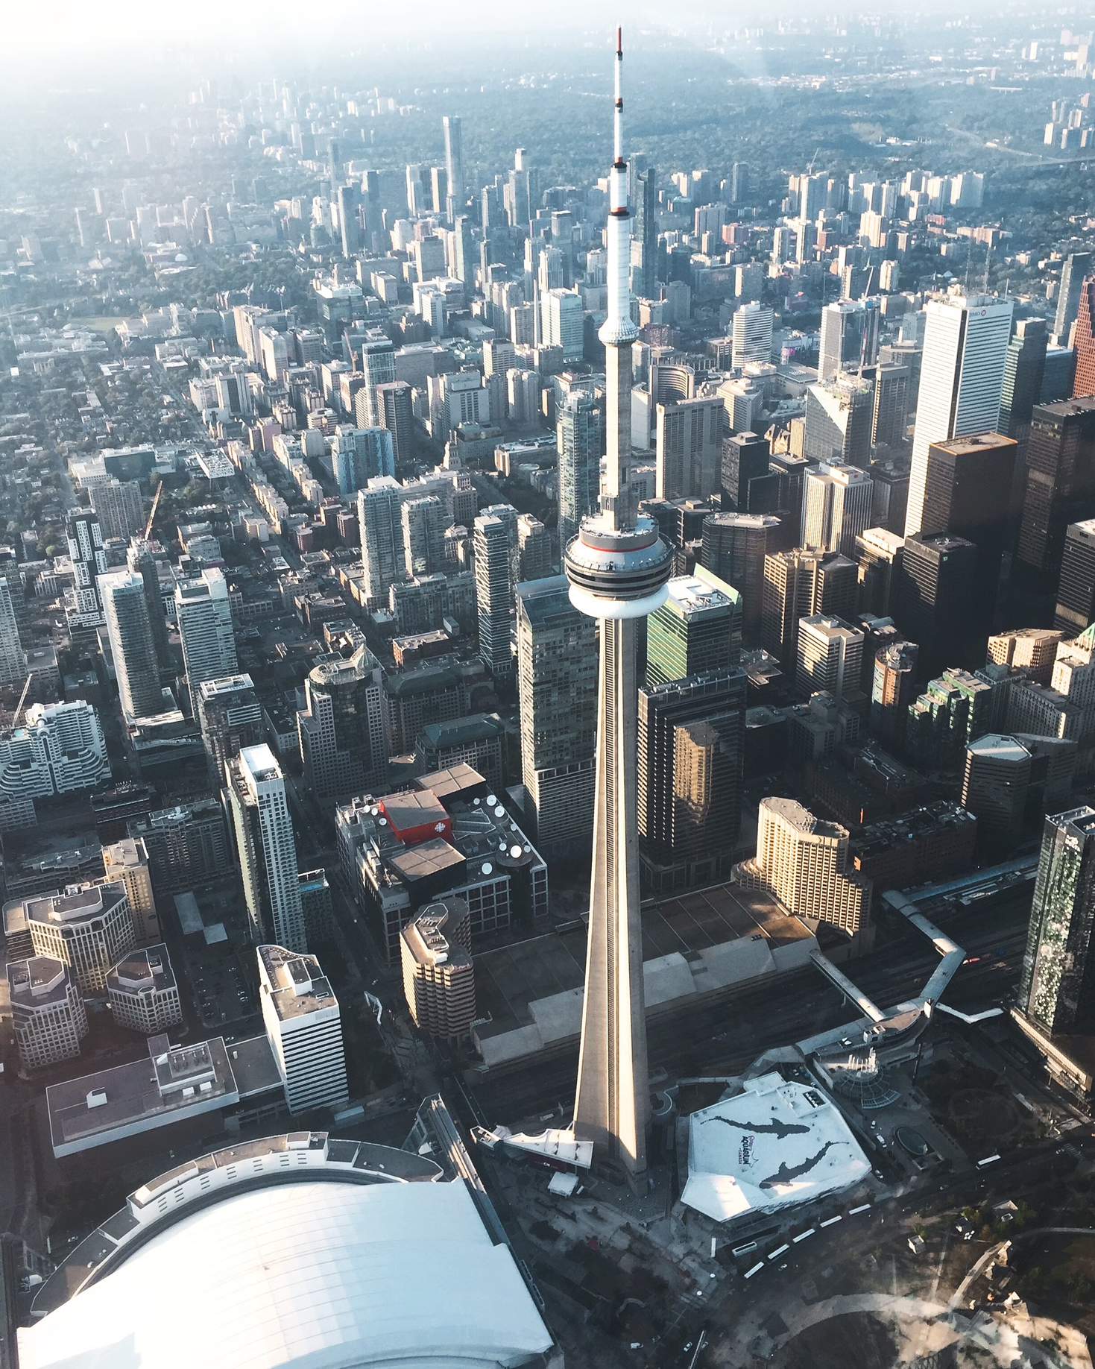
SixSafety
Empowering You and Your Community’s Safety.
Safety in Your Own Hands.
THANK YOU!

Slide 14
Github Repository:
Streamlit - Front-End Survey + LLM Agentic Framework:
https://github.com/allangalli/WiseNeighbourhood/
Safety Plan Generator LLM:
https://github.com/TangoMango223/MMAI5040_TP_Model
Toronto MCI Project - Initial EDA:
https://drive.google.com/drive/folders/19DhgYpnG5w51CRgLtuXzmzOSZ_erdwOt?usp=sharing

Slide 15
REFERENCES - 1
2023 Program Summary Toronto Police Service. Toronto Police Services.
2024 Budget Notes Toronto Police Services Board. Toronto Police Services Board, Sept. 2023.
“2024 Budget- Toronto Police Service.” Www.tps.ca, Toronto Police Services, 2024, www.tps.ca/budget/2024-budget/. Accessed 22 Nov. 2024.
2024 Capital and Operating Budgets - Toronto Police Service, BudgetTO, 18 Jan. 2024, www.toronto.ca/legdocs/mmis/2024/bu/bgrd/backgroundfile-242353.pdf.
“Artificial Intelligence- Toronto Police Service.” Www.tps.ca, Toronto Police, 2022, www.tps.ca/police-reform/artificial-intelligence/. Accessed 22 Nov. 2024.
AWS. “EC2 Instance Pricing – Amazon Web Services (AWS).” Amazon Web Services, Inc., Amazon, 2003, aws.amazon.com/ec2/pricing/on-demand/.
Antunes, Miguel Eiras, et al. Urban Future With a Purpose, Deloitte, www.deloitte.com/content/dam/assets-shared/legacy/docs/perspectives/2022/deloitte-urban-future-with-a-purpose-study-set2021.pdf. Accessed 5 Oct. 2024.
Balintec, Vanessa. “Toronto Mayor John Tory Wants to Boost Police Budget by Nearly $50m | CBC News.” CBCnews, CBC/Radio Canada, 3 Jan. 2023, www.cbc.ca/news/canada/toronto/tory-police-budget-toronto-mayor-1.6702270.
City of Toronto. “Toronto at a Glance.” City of Toronto, City of Toronto, 2023, www.toronto.ca/city-government/data-research-maps/toronto-at-a-glance/.
City of Toronto. “Toronto Transit Commission.” City of Toronto, 25 Aug. 2017, www.toronto.ca/city-government/accountability-operations-customer-service/city-administration/city-managers-office/agencies-corporations/agencies/toronto-transit-commission/.
Cotter, Adam. “Perceptions of and Experiences with Police and the Justice System among the Black and Indigenous Populations in Canada.” Government of Canada, Statistics Canada, Government of Canada, Statistics Canada, 16 Feb. 2022, www150.statcan.gc.ca/n1/pub/85-002-x/2022001/article/00003-eng.html
Environmental Scan, Ottawa Police, www.ottawapolice.ca/en/who-we-are/resources/Documents/Reports-and-Publications/Budget-2022/4---Environmental-Scan.pdf. Accessed 5 Oct. 2024.
Gillis, Wendy. Black and Indigenous People Less Likely to Trust Toronto Police, Survey Finds, Toronto Star, 29 May 2019, www.thestar.com/news/gta/black-and-indigenous-people-less-likely-to-trust-toronto-police-survey-finds/article_ab07c1f3-f496-5734-ba27-e27f156214bb.html.
Heaven, Will Douglas. “Predictive Policing Algorithms Are Racist. They Need to Be Dismantled.” MIT Technology Review, MIT Technology Review, 17 July 2020, www.technologyreview.com/2020/07/17/1005396/predictive-policing-algorithms-racist-dismantled-machine-learning-bias-criminal-justice/.
Ibrahim, Dyna. “Public Perceptions of the Police in Canada’s Provinces, 2019.” Public Perceptions of the Police in Canada’s Provinces, 2019, Government of Canada, Statistics Canada, 25 Nov. 2020, www150.statcan.gc.ca/n1/pub/85-002-x/2020001/article/00014-eng.htm.
“IV. Organizational Factors Affecting Police Discretion.” Government of Canada, 15 Dec. 2021, www.justice.gc.ca/eng/rp-pr/cj-jp/yj-jj/discre/org/supp-appu.html.
Jeffords, Shawn. “Analysis | Is Toronto’s Police Budget Getting a Cut or a Boost? The Answer Depends on Who You Ask | CBC News.” CBCnews, CBC/Radio Canada, 28 Jan. 2024, www.cbc.ca/news/canada/toronto/toronto-police-budget-fight-1.7094937.
Jones, Ryan Patrick. “The Police Budget Is One of Toronto’s Largest Expenses. Here’s What You Need to Know about It.” CBCnews, CBC/Radio Canada, 21 Oct. 2022, www.cbc.ca/news/canada/toronto/toronto-police-spending-1.6623747.
Luna, Javier Canales. “8 Top Open-Source LLMs for 2024 and Their Uses.” Datacamp.com, DataCamp, 14 Nov. 2023, www.datacamp.com/blog/top-open-source-llms. Accessed 31 Oct. 2024.

Slide 16
REFERENCES - 2
Mazowita, Benjamin, and Cristine Rotenberg. The Canadian Police Performance Metrics Framework: Standardized Indicators for Police Services in Canada. Statistics Canada, 11 Sept. 2019.
“Metrics | Ragas.” Ragas.io, Ragas.io, 2023, docs.ragas.io/en/v0.1.21/concepts/metrics/index.html. Accessed 23 Nov. 2024.
“Myron Demkiw - Toronto Police Service.” Www.tps.ca, Toronto Police, www.tps.ca/people/myron-demkiw/. Accessed 2 Oct. 2024.
The Artificial Intelligence and Data Act (AIDA) – Companion Document, Government of Canada, 13 Mar. 2023, ised-isde.canada.ca/site/innovation-better-canada/en/artificial-intelligence-and-data-act-aida-companion-document#s3.
“Police Using Facial Recognition Technology in York, Peel; Advocates Warn of Risks | CBC News.” CBCnews, CBC/Radio Canada, 29 May 2024, www.cbc.ca/news/canada/toronto/police-facial-recognition-software-1.7216242.
“Police-Reported Crime Statistics in Canada, 2023.” Statistics Canada, 25 Aug. 2024, www150.statcan.gc.ca/n1/daily-quotidien/240725/dq240725b-eng.htm.
Powers, Lucas. “Toronto to Explore Municipal Sales Tax as Part of Plan to Tackle ‘unprecedented Financial Crisis’ | CBC News.” CBCnews, CBC/Radio Canada, 16 Aug. 2023, www.cbc.ca/news/canada/toronto/report-toronto-finances-1.6938094.
PUBLIC SAFETY DATA PORTAL: OPEN DATA DOCUMENTATION. Toronto Police, 16 Aug. 2024.
“Recommended Legal Framework for Police Agencies’ Use of Facial Recognition.” Office of the Privacy Commissioner of Canada, 2 May 2022, www.priv.gc.ca/en/opc-actions-and-decisions/advice-to-parliament/2022/s-d_prov_20220502/.
Rutland, Ted. “Canadian Cities Continue to Over-Invest in Policing.” The Conversation, 14 Nov. 2023, theconversation.com/canadian-cities-continue-to-over-invest-in-policing-217344.
“SafeTO: A Community Safety & Well-Being Plan.” City of Toronto, City of Toronto, 1 Feb. 2021, www.toronto.ca/community-people/public-safety-alerts/community-safety-programs/community-safety-well-being-plan/. Accessed 2 Oct. 2024.
Statistics Canada. “The Daily — Canada’s Population Estimates: Strong Population Growth in 2023.” Www150.Statcan.gc.ca, Statistics Canada, 27 Mar. 2024, www150.statcan.gc.ca/n1/daily-quotidien/240327/dq240327c-eng.htm.
Tang, Qiaoyu, et al. “ToolAlpaca: Generalized Tool Learning for Language Models with 3000 Simulated Cases.” ArXiv.org, arXiv, 2023, arxiv.org/abs/2306.05301. Accessed 31 Oct. 2024.
“The Daily — Police-Reported Crime Statistics in Canada, 2023.” Www150.Statcan.gc.ca, Statistics Canada, 25 July 2024, www150.statcan.gc.ca/n1/daily-quotidien/240725/dq240725b-eng.htm. Accessed 1 Oct. 2024.
“Toronto Police Services Board - Use of Artificial Intelligence Technology.” Tpsb.ca, Toronto Police, 22 Feb. 2022, tpsb.ca/policies-by-laws/board-policies/195-use-of-artificial-intelligence-technology. Accessed 18 Nov. 2024.

Slide 17
APPENDIX DIRECTORY
Interview Insights
Canadian Police Performance Metric Framework
PESTEL Analysis
Model Architecture
Preliminary Structure - Toronto MCI Dataset
EDA Visualizations
Value Generated
Risks & Mitigation
Sources in Document Corpus
(Part 1) SixSafety Survey Explained
(Part 2) Safety Plan Generation Explained
Toronto Police
“Use of AI” Policy
Future Steps for SixSafety
Leveraging Open-Source Models
Implementation Costs
Model Evaluation:
Overview
Model Evaluation:
Metrics Used
Model Evaluation:
Results
“Human in the Loop” Findings
LLM Performance Metrics & Costs
Model Evaluation & Limitations (Expanded explanation)
Sample Feedback
Survey

Slide 18
APPENDIX A: Insights from Anonymous Sources, Toronto Police
Crime Data, Reporting, and Importance of Community Engagement:
Note that all crime incidence data is what is “reported” to police, so underreporting of crimes can distort data, making it essential to account for anomalies in our model validation process. (1)
It was advised to avoid analysis of “Theft Over $5000” category (which excludes auto-theft) in the Toronto MCI dataset, as this dataset does not reflect the higher prices due to inflation in recent years. (2)
A major challenge in policing is underreporting of crimes, particularly thefts. Encouraging communities to recognize and report crime trends is critical to improving public safety, emphasizing the importance of community engagement. (2)
Slow Digitalization in Policing:
There is slow progress towards digital tools for reporting, highlighting the need for AI-driven solutions to optimize resource allocation and improve response times. (1)
Currently Toronto Police only allows for digital reporting of smaller crimes, such as “Parking Complaints”, “Graffiti and Vandalism”, “Traffic/Driving Complaints”. One of the cited reasons was the long procurement and approval process, and that people generally prefer speaking with someone from Toronto Police if the crime personally and directly affects them. (1)
Priorities of Toronto Police Leadership:
Aside from the standard performance metrics of policing agencies in Canada (see Appendix B), it was revealed that the current Toronto Leadership team (under Chief Myron Andrew Demkiw) are more “data-driven” than previous Toronto Leadership teams. (2)
For example, this has driven the creation of “menus” of data visualizations, dashboards and findings, where the Leadership Team can find relevant statistics about a specific category, looking at specific metrics, i.e. if a shooting occurred, the Team would like to see statistics in a dashboard about shooting for specific times, etc. (2)
Sensitivity surrounding Data Tools:
It is strongly recommended to allow people who view Toronto Police data to “curate” views and dashboards, as seen from Toronto Police’s Open Data dashboards, as there were issues in the past regarding sensitivity about the findings, versus people uncovering these findings on their own. If anyone decides to build an index, it’s highly recommended to keep it internal facing, avoid public usage, i.e. safety scores (2)
Effect of Budget Cuts and Prioritization:
It is mandated that Toronto Police must answer all 911 calls, thus answering responses will be prioritized. (2)
What would likely be reduced or eliminated if there were Police Budget Cuts: Less investigative work, community initiatives and engagement activities, supporting units would be cut, and reduction of police equipment and materials. (2)
What would likely not be affected: emerging technologies, technology, IT, body-cameras, etc. (2)
Sources:
(1) An anonymous interviewee from Toronto Police at Public Division Station, interviewed in person on September 26, 2024, between 12:30 PM and 12:50 PM, stated that public safety initiatives must prioritize crime prevention over reactive measures.
(2) A second, different anonymous interviewee from Toronto Police, conducted on September 30, 2024, at 8:30 PM, the interviewee explained more regarding key metrics, objectives of Toronto Police, and more on the data-driven approach findings.

Slide 19
(Mazowita, Benjamin, and Cristine Rotenberg., 2019)
APPENDIX B: Canadian Police Performance Metrics Framework
Dimension | Explanation | Example Metrics | How our analytical approach may benefit this dimension:
Crime and Victimization | Measure incidences of crime, victimization, bringing offenders to account. | Crime Rates Youth Crime Rates Traffic Violations Crime severity occurrence Court outcomes | Provide suggestions for reducing crime occurrence rates per major category Improved and encouraging reporting, engaging the community.
Police Activities and Deployment | Police functions, activities that contribute to public safety, including non-crime related policing initiatives. | Time allocations (busy codes) Response times Outcomes from community initiatives | Current Toronto Police Chief Myron Denkiw is a supporter of community initiatives, as one of the early champions of “SafeTO”, a community initiative to improve public safety by collaborating with different business sectors, government and the public. Our approach will directly support SafeTO goals, supporting community initiatives that could improve community relationships and optimize police resource allocations (in light of budget scrutiny). Improvement to response times
Police Resources | Police personnel, operating expenditures and associated costs. | Retention Training hours Staffing needs | Efficient resource use. Budget-driven deployment. Smarter investments in training.
Trust and Confidence in Police | Canadian trust and confidence in police, perceptions of police legitimacy. | Surveys, such as General Social Survey Social Media Engagement Incidences of police misconduct | Increased public transparency. Improved public engagement. Stronger community relationships.
Our approach considers all important performance metrics that Toronto Leadership measures, and consider the community engagement component.

Slide 20
Appendix C: Full External Analysis - PESTEL Framework
Political | Economic | Social | Technological | Legal
Annually, Toronto Police’s budget is determined by the City Council. (Jeffords, 2024) In early 2024, the city of Toronto approved Toronto Police’s budget (including a $20 million increase), after a highly publicized conflict between mayor Olivia Chow and the Chief of Police, where the City Council originally only partially approved the increase. This contrasts greatly with former mayor John Tory, who historically supported police budget increases. (Balintec, 2023) Other police forces such as Ottawa Police have identified political climate, such as elections of political parties at all levels of government, playing an important role in police operations. For example, political plans such as “Stronger Canada”, which emphasize focus areas such as community engagement. (Environmental scan, 2022) | In 2024, the City of Toronto is currently facing a $1.8 billion budget deficit (Jeffords, 2024), largely due to lower revenues and higher operating costs due to COVID-19, and inflation (Powers, 2023). Although Toronto City Council granted the full Toronto Police budget and increase in 2024, there is growing pressure from city council for Toronto Police to find ways to cut costs and allocate police resources to ensure future funding, and also improve key metrics such as response times. Financially, Toronto Police’s budget accounts for ~7% (Jones, 2022) of the city’s total budget, with budget allocations for police forces varying widely in Canada (Rutland, 2023). | In 2023 (Police-reported crime statistics in Canada, 2023), following a downward trend due to the COVID-19 pandemic, there is now an upward trend of crime (both violent and non-violent) since 2022, with a notable uptick of non-violent crimes, such as fraud and auto-theft seeing higher increases. (Note: This is from reported police crimes, so factors such as improved reporting may affect results). When a police agency has initiatives (IV. Organizational Factors Affecting Police Discretion, 2021) towards community engagement and policing, officers are more likely to make referrals to external agencies that provide supporting resources to youths, leading to improved outcomes. Public trust and confidence in the police force varies in Canada (Ibrahim, 2020), such as having higher trust in metropolitan areas, and older Canadians have more confidence. Some factors, such as ethnic background, do affect trust (i.e. visible minorities reporting less trust towards policing (Cotter, 2022)). Nationally, ~67% of Canadians report to have a high level of confidence in the police (Confidence in the police, the justice system and courts, the Federal Parliament, and the Canadian media varied across racialized groups, 2023). Finally, there has been controversy regarding policing due to discrimination and racism towards visible minority communities (Gillis, 2019), with calls for police transparency and accountability (Environmental scan, 2022). | Recent studies have shown that smart technologies such as AI could help reduce crime by 30-40% and reduce response times by 20-35%, such as gun-shot detection, crowd-controls and more (Antunes et al., 2022). In Canada, Toronto Police and other police forces are increasingly adopting new AI tools, such as predictive modeling, facial recognition (Police using facial recognition technology…, 2024 ). Increasingly, police forces in Canada are considering guidelines to moderate usage of new technologies like AI. For example, since 2022, the force has a “Use of Artificial Intelligence. The International Data Corporation (IDC) found that police agencies that adopted digitalization experienced better workflows to support community safety initiatives (Antunes et al. 2022). | There are ongoing concerns regarding privacy and ethical use of new technologies like AI or facial recognition in policing. Recent examples include an investigation of RCMP’s usage of ClearView, largely from the lack of frameworks and earlier disclosure of facial recognition usage on the Canadian public (Recommended legal framework for police agencies' use of facial recognition, 2022). There are growing calls for the regulation and moderation for usage of predictive modeling in policing (Heaven, 2020), especially as studies have shown that unmoderated tools can perpetuate racism and biases (as the historical data may have been biased). One major concern is the ability of training data for various groups, the bias in historical data, and “tech washing”, which utilizes technology to hide inequities. One proposed regulation is the Canadian “Artificial Intelligence and Data Act” (AIDA), which is still under review (The Artificial Intelligence and Data Act, 2023). Part of Bill C-27, it will serve as a framework to introduce regulations to guide AI innovation, training, development and deployment of AI models, and establish penalties for organization, such as using AI systems that would likely cause harm and unlawfully collected personal data.
Annually, Toronto Police’s budget is determined by the City Council. (Jeffords, 2024) In early 2024, the city of Toronto approved Toronto Police’s budget (including a $20 million increase), after a highly publicized conflict between mayor Olivia Chow and the Chief of Police, where the City Council originally only partially approved the increase. This contrasts greatly with former mayor John Tory, who historically supported police budget increases. (Balintec, 2023) Other police forces such as Ottawa Police have identified political climate, such as elections of political parties at all levels of government, playing an important role in police operations. For example, political plans such as “Stronger Canada”, which emphasize focus areas such as community engagement. (Environmental scan, 2022) | In 2024, the City of Toronto is currently facing a $1.8 billion budget deficit (Jeffords, 2024), largely due to lower revenues and higher operating costs due to COVID-19, and inflation (Powers, 2023). Although Toronto City Council granted the full Toronto Police budget and increase in 2024, there is growing pressure from city council for Toronto Police to find ways to cut costs and allocate police resources to ensure future funding, and also improve key metrics such as response times. Financially, Toronto Police’s budget accounts for ~7% (Jones, 2022) of the city’s total budget, with budget allocations for police forces varying widely in Canada (Rutland, 2023). | In 2023 (Police-reported crime statistics in Canada, 2023), following a downward trend due to the COVID-19 pandemic, there is now an upward trend of crime (both violent and non-violent) since 2022, with a notable uptick of non-violent crimes, such as fraud and auto-theft seeing higher increases. (Note: This is from reported police crimes, so factors such as improved reporting may affect results). When a police agency has initiatives (IV. Organizational Factors Affecting Police Discretion, 2021) towards community engagement and policing, officers are more likely to make referrals to external agencies that provide supporting resources to youths, leading to improved outcomes. Public trust and confidence in the police force varies in Canada (Ibrahim, 2020), such as having higher trust in metropolitan areas, and older Canadians have more confidence. Some factors, such as ethnic background, do affect trust (i.e. visible minorities reporting less trust towards policing (Cotter, 2022)). Nationally, ~67% of Canadians report to have a high level of confidence in the police (Confidence in the police, the justice system and courts, the Federal Parliament, and the Canadian media varied across racialized groups, 2023). Finally, there has been controversy regarding policing due to discrimination and racism towards visible minority communities (Gillis, 2019), with calls for police transparency and accountability (Environmental scan, 2022). | Recent studies have shown that smart technologies such as AI could help reduce crime by 30-40% and reduce response times by 20-35%, such as gun-shot detection, crowd-controls and more (Antunes et al., 2022). In Canada, Toronto Police and other police forces are increasingly adopting new AI tools, such as predictive modeling, facial recognition (Police using facial recognition technology…, 2024 ). Increasingly, police forces in Canada are considering guidelines to moderate usage of new technologies like AI. For example, since 2022, the force has a “Use of Artificial Intelligence. The International Data Corporation (IDC) found that police agencies that adopted digitalization experienced better workflows to support community safety initiatives (Antunes et al. 2022). | There are ongoing concerns regarding privacy and ethical use of new technologies like AI or facial recognition in policing. Recent examples include an investigation of RCMP’s usage of ClearView, largely from the lack of frameworks and earlier disclosure of facial recognition usage on the Canadian public (Recommended legal framework for police agencies' use of facial recognition, 2022). There are growing calls for the regulation and moderation for usage of predictive modeling in policing (Heaven, 2020), especially as studies have shown that unmoderated tools can perpetuate racism and biases (as the historical data may have been biased). One major concern is the ability of training data for various groups, the bias in historical data, and “tech washing”, which utilizes technology to hide inequities. One proposed regulation is the Canadian “Artificial Intelligence and Data Act” (AIDA), which is still under review (The Artificial Intelligence and Data Act, 2023). Part of Bill C-27, it will serve as a framework to introduce regulations to guide AI innovation, training, development and deployment of AI models, and establish penalties for organization, such as using AI systems that would likely cause harm and unlawfully collected personal data.
Annually, Toronto Police’s budget is determined by the City Council. (Jeffords, 2024) In early 2024, the city of Toronto approved Toronto Police’s budget (including a $20 million increase), after a highly publicized conflict between mayor Olivia Chow and the Chief of Police, where the City Council originally only partially approved the increase. This contrasts greatly with former mayor John Tory, who historically supported police budget increases. (Balintec, 2023) Other police forces such as Ottawa Police have identified political climate, such as elections of political parties at all levels of government, playing an important role in police operations. For example, political plans such as “Stronger Canada”, which emphasize focus areas such as community engagement. (Environmental scan, 2022) | In 2024, the City of Toronto is currently facing a $1.8 billion budget deficit (Jeffords, 2024), largely due to lower revenues and higher operating costs due to COVID-19, and inflation (Powers, 2023). Although Toronto City Council granted the full Toronto Police budget and increase in 2024, there is growing pressure from city council for Toronto Police to find ways to cut costs and allocate police resources to ensure future funding, and also improve key metrics such as response times. Financially, Toronto Police’s budget accounts for ~7% (Jones, 2022) of the city’s total budget, with budget allocations for police forces varying widely in Canada (Rutland, 2023). | In 2023 (Police-reported crime statistics in Canada, 2023), following a downward trend due to the COVID-19 pandemic, there is now an upward trend of crime (both violent and non-violent) since 2022, with a notable uptick of non-violent crimes, such as fraud and auto-theft seeing higher increases. (Note: This is from reported police crimes, so factors such as improved reporting may affect results). When a police agency has initiatives (IV. Organizational Factors Affecting Police Discretion, 2021) towards community engagement and policing, officers are more likely to make referrals to external agencies that provide supporting resources to youths, leading to improved outcomes. Public trust and confidence in the police force varies in Canada (Ibrahim, 2020), such as having higher trust in metropolitan areas, and older Canadians have more confidence. Some factors, such as ethnic background, do affect trust (i.e. visible minorities reporting less trust towards policing (Cotter, 2022)). Nationally, ~67% of Canadians report to have a high level of confidence in the police (Confidence in the police, the justice system and courts, the Federal Parliament, and the Canadian media varied across racialized groups, 2023). Finally, there has been controversy regarding policing due to discrimination and racism towards visible minority communities (Gillis, 2019), with calls for police transparency and accountability (Environmental scan, 2022). | Recent studies have shown that smart technologies such as AI could help reduce crime by 30-40% and reduce response times by 20-35%, such as gun-shot detection, crowd-controls and more (Antunes et al., 2022). In Canada, Toronto Police and other police forces are increasingly adopting new AI tools, such as predictive modeling, facial recognition (Police using facial recognition technology…, 2024 ). Increasingly, police forces in Canada are considering guidelines to moderate usage of new technologies like AI. For example, since 2022, the force has a “Use of Artificial Intelligence. The International Data Corporation (IDC) found that police agencies that adopted digitalization experienced better workflows to support community safety initiatives (Antunes et al. 2022). | There are ongoing concerns regarding privacy and ethical use of new technologies like AI or facial recognition in policing. Recent examples include an investigation of RCMP’s usage of ClearView, largely from the lack of frameworks and earlier disclosure of facial recognition usage on the Canadian public (Recommended legal framework for police agencies' use of facial recognition, 2022). There are growing calls for the regulation and moderation for usage of predictive modeling in policing (Heaven, 2020), especially as studies have shown that unmoderated tools can perpetuate racism and biases (as the historical data may have been biased). One major concern is the ability of training data for various groups, the bias in historical data, and “tech washing”, which utilizes technology to hide inequities. One proposed regulation is the Canadian “Artificial Intelligence and Data Act” (AIDA), which is still under review (The Artificial Intelligence and Data Act, 2023). Part of Bill C-27, it will serve as a framework to introduce regulations to guide AI innovation, training, development and deployment of AI models, and establish penalties for organization, such as using AI systems that would likely cause harm and unlawfully collected personal data.
Annually, Toronto Police’s budget is determined by the City Council. (Jeffords, 2024) In early 2024, the city of Toronto approved Toronto Police’s budget (including a $20 million increase), after a highly publicized conflict between mayor Olivia Chow and the Chief of Police, where the City Council originally only partially approved the increase. This contrasts greatly with former mayor John Tory, who historically supported police budget increases. (Balintec, 2023) Other police forces such as Ottawa Police have identified political climate, such as elections of political parties at all levels of government, playing an important role in police operations. For example, political plans such as “Stronger Canada”, which emphasize focus areas such as community engagement. (Environmental scan, 2022) | In 2024, the City of Toronto is currently facing a $1.8 billion budget deficit (Jeffords, 2024), largely due to lower revenues and higher operating costs due to COVID-19, and inflation (Powers, 2023). Although Toronto City Council granted the full Toronto Police budget and increase in 2024, there is growing pressure from city council for Toronto Police to find ways to cut costs and allocate police resources to ensure future funding, and also improve key metrics such as response times. Financially, Toronto Police’s budget accounts for ~7% (Jones, 2022) of the city’s total budget, with budget allocations for police forces varying widely in Canada (Rutland, 2023). | In 2023 (Police-reported crime statistics in Canada, 2023), following a downward trend due to the COVID-19 pandemic, there is now an upward trend of crime (both violent and non-violent) since 2022, with a notable uptick of non-violent crimes, such as fraud and auto-theft seeing higher increases. (Note: This is from reported police crimes, so factors such as improved reporting may affect results). When a police agency has initiatives (IV. Organizational Factors Affecting Police Discretion, 2021) towards community engagement and policing, officers are more likely to make referrals to external agencies that provide supporting resources to youths, leading to improved outcomes. Public trust and confidence in the police force varies in Canada (Ibrahim, 2020), such as having higher trust in metropolitan areas, and older Canadians have more confidence. Some factors, such as ethnic background, do affect trust (i.e. visible minorities reporting less trust towards policing (Cotter, 2022)). Nationally, ~67% of Canadians report to have a high level of confidence in the police (Confidence in the police, the justice system and courts, the Federal Parliament, and the Canadian media varied across racialized groups, 2023). Finally, there has been controversy regarding policing due to discrimination and racism towards visible minority communities (Gillis, 2019), with calls for police transparency and accountability (Environmental scan, 2022). | Recent studies have shown that smart technologies such as AI could help reduce crime by 30-40% and reduce response times by 20-35%, such as gun-shot detection, crowd-controls and more (Antunes et al., 2022). In Canada, Toronto Police and other police forces are increasingly adopting new AI tools, such as predictive modeling, facial recognition (Police using facial recognition technology…, 2024 ). Increasingly, police forces in Canada are considering guidelines to moderate usage of new technologies like AI. For example, since 2022, the force has a “Use of Artificial Intelligence. The International Data Corporation (IDC) found that police agencies that adopted digitalization experienced better workflows to support community safety initiatives (Antunes et al. 2022). | There are ongoing concerns regarding privacy and ethical use of new technologies like AI or facial recognition in policing. Recent examples include an investigation of RCMP’s usage of ClearView, largely from the lack of frameworks and earlier disclosure of facial recognition usage on the Canadian public (Recommended legal framework for police agencies' use of facial recognition, 2022). There are growing calls for the regulation and moderation for usage of predictive modeling in policing (Heaven, 2020), especially as studies have shown that unmoderated tools can perpetuate racism and biases (as the historical data may have been biased). One major concern is the ability of training data for various groups, the bias in historical data, and “tech washing”, which utilizes technology to hide inequities. One proposed regulation is the Canadian “Artificial Intelligence and Data Act” (AIDA), which is still under review (The Artificial Intelligence and Data Act, 2023). Part of Bill C-27, it will serve as a framework to introduce regulations to guide AI innovation, training, development and deployment of AI models, and establish penalties for organization, such as using AI systems that would likely cause harm and unlawfully collected personal data.
There are opportunities for technology to support public safety in policing, however, the community must be engaged and involved. This will improve success, especially when considering potential challenges such as incoming regulations, public perception and scrutiny over Toronto Police budget.

Slide 21
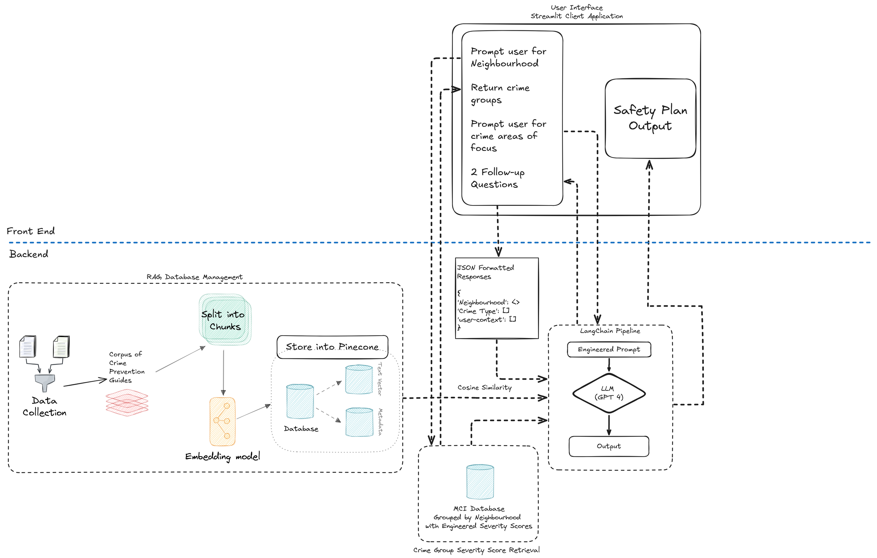
Appendix D: MODEL ARCHITECTURE

Slide 22
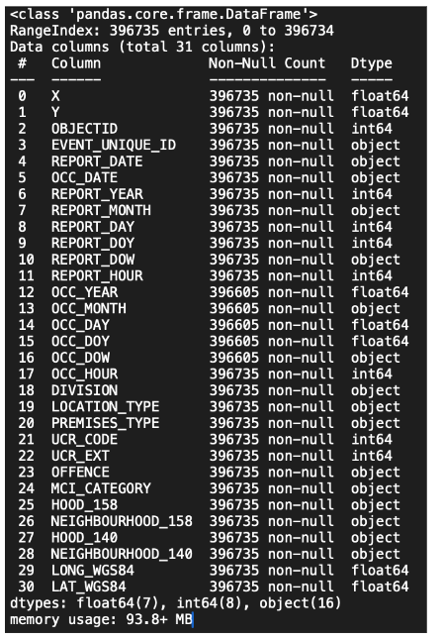
APPENDIX E: Preliminary Information - Data Structure, Toronto MCI
Link to Toronto MCI Dataset:
General Comments:
Approximately ~130 rows of missing values for “Occurrence” related columns, as the exact date and time for crimes were likely unknown.
~396K+ rows
Duplicate Records due to data reporting issues, or
Geographical data from LAT/LONG is also incomplete and inaccurate data entry/reporting
Dataset has two types of neighbourhood location mapping, 158 vs. 140 due to City of Toronto’s new neighbourhood mapping beginning in 2022.
Despite some issues, this dataset is relatively complete.
Additional Dataset to Complement Analysis, i.e. Neighbourhood information:

Slide 23
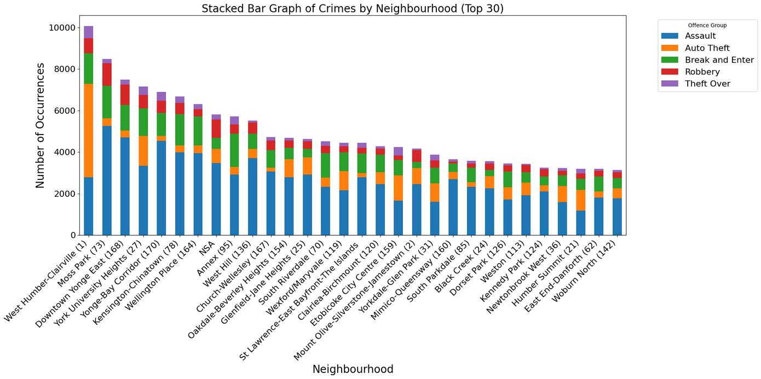
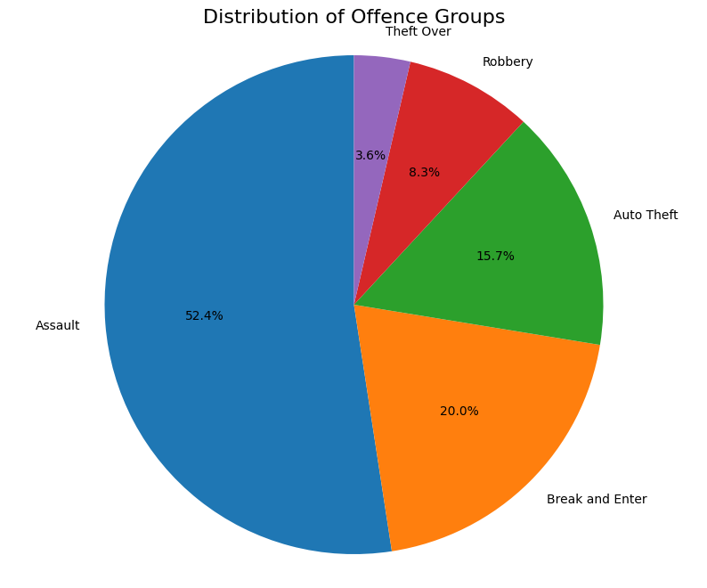
APPENDIX F: Exploratory Data Visualization
Offence groups do not have balanced distribution on the whole, and different neighbourhoods have varying distributions across offence groups, and have different total occurrences. Occurrences must be normalized by population to gain meaningful insight.

Slide 24
APPENDIX G: Value Generation for Toronto Police
SixSafety is a system that could support Toronto Police’s annual $100 million Cost Avoidance strategy, which is implementing proactive, community engagement programs and activities to control costs.
Path to Digitalization: Toronto Police’s 2024 Budget Research findings discovered that 91% of respondents said it was important to report low-priority crimes online
SixSafety complements online reporting tools, providing immediate safety recommendations as individuals report online
Enhance Resource Efficiency and Response Prioritization: By equipping residents with personalized safety plans based on localized crime data, the tool can reduce reliance on non-urgent calls to law enforcement, enabling the Toronto Police to allocate resources more effectively toward high-priority incidents and investigations.
Current 911 response times for Toronto Police is 22 minutes
Help Toronto Police prioritize resources
Complement existing community engagement programs, such as Neighborhood Community Officer program, to resolve localized issues, bridging the gap where immediate human support may not be possible
Also supports SafeTO community program, and other goals of Toronto Police to engage with the community and collaboratively work to address public safety
2023 Program Summary Toronto Police Service. Toronto Police Services.
2024 Budget Notes Toronto Police Services Board. Toronto Police Services Board, Sept. 2023.
“2024 Budget- Toronto Police Service.” Www.tps.ca, Toronto Police Services, 2024, www.tps.ca/budget/2024-budget/. Accessed 22 Nov. 2024.

Slide 25
APPENDIX H: Risk and Mitigation Strategy
Risk: | Mitigation Strategy
Data Privacy and Security Breaches | Data Minimization: Continue current approach, where only demographics data collected is about the neighborhood Secure Data Storage: Utilize encrypted databases and strict access controls
Hallucination from LLM responses | Human oversight (i.e. human in the loop) to regularly review the outputs and data used for the safety plan generation, and the survey input questions Careful prompt-engineering to restrict possible responses while balancing reliability and actionability of recommendations Feedback mechanisms in the future to report any inappropriate responses
Bias in Safety Recommendations | Increase corpus by including documents with different perspectives, to reduce bias in safety recommendations, leveraging expertise of domain experts Leverage bias detection and assessment tools, such as IBM’s AI Fairness 360 package, to check equal outcomes in safety plan generation
Google. “Google Responsible AI Practices.” Google AI, 2024, ai.google/responsibility/responsible-ai-practices/.
Kosinski, Matthew, and Amber Forrest. “What Is a Prompt Injection Attack? | IBM.” Www.ibm.com, 11 Apr. 2024, www.ibm.com/topics/prompt-injection.
Team ThoughtSpot. “Security and Risk Mitigation in an LLM World.” ThoughtSpot, 24 June 2024, www.thoughtspot.com/data-trends/ai/security-risk-mitigation-llm?utm_source=chatgpt.com. Accessed 22 Nov. 2024.

Slide 26
APPENDIX I: Sources in Document Corpus
The following resources were used to build the vector database (Pinecone) for information retrieval:
City of Toronto website
Toronto Police website
Toronto Transit Commission (TTC)
Retail Council of Canada
Government of Canada – Public Safety
As a proof of concept, we leveraged scraping/crawling tools such as FireCrawl in Python, several webpages were extracted, and the information was loaded in the Vector Database.
In future implementations, we will leverage domain experts to include more relevant documents and aligning with Term of Use for the content on websites for full permission to utilize their content.
Currently, only Toronto Police and Government of Canada have open licenses for non-commercial usage.
You can view the full spreadsheet of resources used here:
https://docs.google.com/spreadsheets/d/1PEVuqlUrvVoJJUflYGq4gN6itj9WZzGB-UHYnsIusng/edit?usp=sharing

Slide 27
APPENDIX J: (Part 1) SixSafety Survey Explanation
Technology Aspects: Python, Streamlit library, LangChain library, LangSmith, OpenAI GPT-4
The general public in City of Toronto will complete a survey asking for 4 aspects of information: (1) Neighborhood, (2) 1 Focus area for crime type (that the user is concerned about), and (3) Answering no more than 3 questions.
This leverages an LLM Agentic Framework, where more than two different large language models make decisions about how to proceed with the conversation.
Agent 1 – Generates GUI, and also questions to retrieve more information
Agent 2 – Uses this information to think, reason, and communicates with user
This is also an example of disambiguation, where any uncertainty with user input is resolved.
For example, if user indicated “Robbery” as a crime type focus, the Agent #1 will brainstorm questions to ask to get more clarification.
LLM Guardrails in Prompt-Engineering:
Clearly defined roles and expectations, boundaries in what may be suggested (i.e. do not provide medical/legal advice).
Human evaluation was conducted to ensure Agent #1 and #2 do not provide any inappropriate comments
1-way conversation with multiple-choice options, to prevent prompt injection attacks or inappropriate input from users.

Slide 28
APPENDIX K: (Part 2) Safety Plan Generation Explained
Technology Aspects: Python, LangChain, LangSmith for performance tracking, OpenAI GPT-4
Important Components applied at this part:
Chain of Thought Reasoning: First prompt requires analyzing the information provided; second prompt focused on transforming analysis to structured safety plan
One-Shot Learning:From human evaluation, we selected the best example of a safety-plan output for the LLM to understand and ensure consistent format and style
LangChainPipeline: Leveraged LangChain library to construct pipeline so data flows between each action, resulting in the safety plan output
RAG (InformationRetrieval):
Pinecone Vector Database for document retrieval
Embeddings (aka numerical representation to allow for information retrieval), used “text-3-large” embeddings from Open AI

Slide 29
APPENDIX L: Toronto Police “Use of AI” Policy
Toronto Police released a “Use of Artificial Intelligence” Policy, beginning in February 2022.
Important Policy Components:
Guiding Principles: AI Technologies used by Toronto Police must comply with legal standards, and uphold: fairness, reliability, justifiability, personal and organizational accountability, transparency, privacy, and meaningfully engage the public
Review and Assess: Toronto Police’s Chief of Police and Team are tasked to develop the procedures to evaluate new AI Technologies, and to categorize them by risk-level, and to review accordingly
Reporting: The Chief must report to the Board as required by the policy.
Implementation for SixSafety:
Must ensure fairness and reliability are built in, such diverse and representative documents for corpus, by leveraging domain experts (i.e. community engagement, members of the public in City of Toronto, Toronto Police)
Protect privacy: Continue to ensure SixSafety practices data minimization (minimal collection), complying with privacy laws. Currently, nothing is collected, and we only ask for neighbourhood and some survey questions.
Transparency: Clarity on how SixSafety makes the recommendations (i.e. RAG)
Facilitate Public Engagement: Leverage domain experts and the general public to get feedback to address concerns.
Implications for Future Next Steps, see next Appendix “Future Steps for SixSafety”
“Artificial Intelligence- Toronto Police Service.” Www.tps.ca, Toronto Police, 2022, www.tps.ca/police-reform/artificial-intelligence/. Accessed 22 Nov. 2024.
“Toronto Police Services Board - Use of Artificial Intelligence Technology.” Tpsb.ca, Toronto Police, 22 Feb. 2022, tpsb.ca/policies-by-laws/board-policies/195-use-of-artificial-intelligence-technology. Accessed 18 Nov. 2024.

Slide 30
APPENDIX M: Future Steps for SixSafety
Development and Testing - Estimated Duration: 6-12 months
Work with domain experts (i.e. Toronto Police) and other experts on public safety to grow document corpus (i.e. so LLM has more resources to provide better recommendations).
Develop “gold standard” plans with input from domain experts
Continue prompt engineering and implementing future guardrails.
Conduct regular testing for bias and fairness, review dataset used to mitigate potential biases, look at recommendations per neighborhood (i.e. demographics checking)
There are many libraries that are available to ensure equal outcomes to groups, such as:
1.Microsoft - Fairlearn Toolkit
2.IBM - AI Fairness 360
Alignment to TorontoPolice’s Use of AI Technologies Policy (Ongoing, to begin when project initiates)
Work with Toronto Police to define goals on costs / budget, latency, and other performance metrics, as future prompting techniques or changes will depend on the goals
Adopt “privacy by design” and default, ensuring compliance with Ontario data privacy regulations and laws.
Align SixSafety system’s design with evaluation expectations from this policy
Develop reporting frameworks and continue tracking
Trial Runs, Testing and Pilot - Duration: 6-8 months
Soft Launch – deploy tool publicly with limited public outreach to observe usage
Work with Toronto Police’s internal teams to plan and transition to Toronto Police’s infrastructure, i.e. servers
Monitor user engagement, performance, implement feedback
Community Engagement and Public Awareness - Duration: ~4-6 months campaign
Work with Toronto Police to align with existing Community Engagement initiatives and projects to spread awareness of this tool
Solicit public feedback for continous improvement

Slide 31
APPENDIX N: Leveraging Open-Source Models
Depending on Toronto Police’s decisions regarding the model architecture, there may be concerns that require switching to open-source models, versus the current approach (OpenAI GPT-4).
Reasoning:
Data Localization – keep all the data sent and inference to LLM within Canada and within Toronto Police servers, i.e. hosted on local server or machine
Alignment with any Toronto Police policies and legal compliance
Challenges:
Response quality may not be as good as existing proprietary models, such as OpenAI’s ChatGPT or Claude.
However, this is an emerging field of improving open-source models, such as leveraging tools like ToolApaca to fine-tune smaller, open-source LLMs models for better output
Additionally, there are new solutions such as Cohere (Canadian Enterprise AI platform), which resolves the issue of data localization, provides secure, private deployment, and does not send client’s data outside of their own architecture, with their own LLM model, Command R.
Luna, Javier Canales. “8 Top Open-Source LLMs for 2024 and Their Uses.” Datacamp.com, DataCamp, 14 Nov. 2023, www.datacamp.com/blog/top-open-source-llms. Accessed 31 Oct. 2024.
Tang, Qiaoyu, et al. “ToolAlpaca: Generalized Tool Learning for Language Models with 3000 Simulated Cases.” ArXiv.org, arXiv, 2023, arxiv.org/abs/2306.05301. Accessed 31 Oct. 2024.

Slide 32
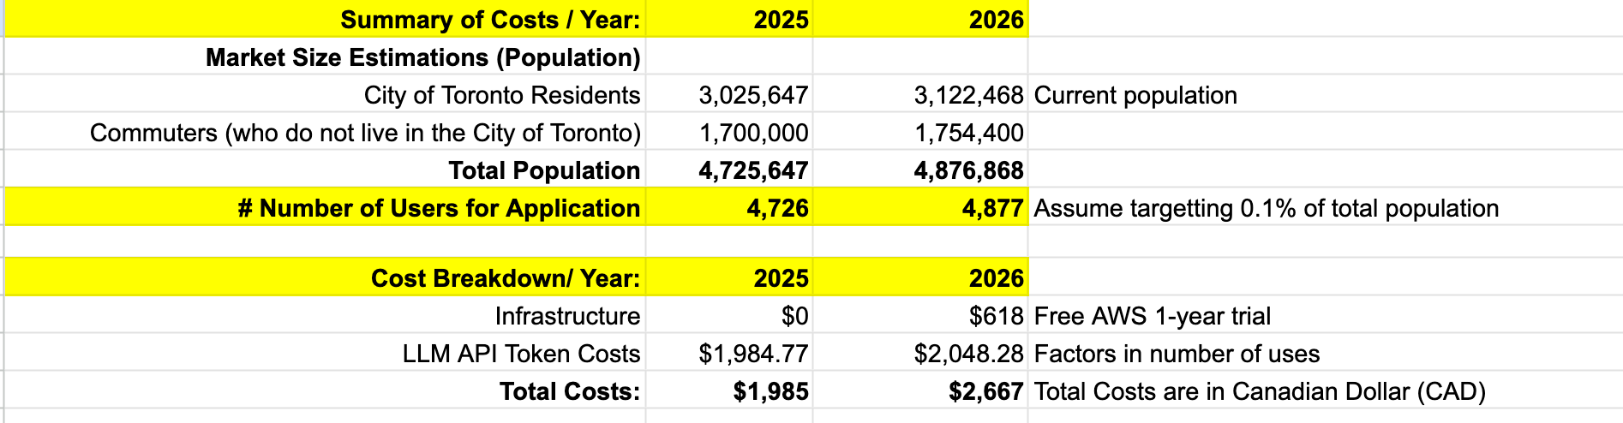
APPENDIX O: Implementation Costs
Full Cost Breakdown:
https://docs.google.com/spreadsheets/d/1PEVuqlUrvVoJJUflYGq4gN6itj9WZzGB-UHYnsIusng/edit?usp=sharing
AWS. “EC2 Instance Pricing – Amazon Web Services (AWS).” Amazon Web Services, Inc., Amazon, 2003, aws.amazon.com/ec2/pricing/on-demand/.
City of Toronto. “Toronto at a Glance.” City of Toronto, City of Toronto, 2023, www.toronto.ca/city-government/data-research-maps/toronto-at-a-glance/.
---. “Toronto Transit Commission.” City of Toronto, 25 Aug. 2017, www.toronto.ca/city-government/accountability-operations-customer-service/city-administration/city-managers-office/agencies-corporations/agencies/toronto-transit-commission/.
Statistics Canada. “The Daily — Canada’s Population Estimates: Strong Population Growth in 2023.” Www150.Statcan.gc.ca, Statistics Canada, 27 Mar. 2024, www150.statcan.gc.ca/n1/daily-quotidien/240327/dq240327c-eng.htm.

Slide 33
APPENDIX P: Model Evaluation - Overview
The evaluations primarily focused on the final output to the user – the generated safety plan
The evaluation was divided into two components:
Python Library RAGAS:
Information Retrieval (RAG)
Quality of LLM Generated Output
Incorporating human evaluation in the process
LangSmith - Performance Metrics
Latency
Cost
Trace Analysis – i.e. proper code running, error monitoring if the LLM’s call failed, etc.

Slide 34
APPENDIX Q: Model Evaluation - Metrics Used
Information Retrieval (RAG) - focus on document relevancy of the information retrieved, and given to the LLM to generate safety plan
Context Precision - How relevant the retrieved documents are, to the goal of creating a safety plan; uses semantic similarity to determine.
Context Recall - The proportion of “ideal answer / ground truth” claims found in retrieved documents; uses semantic similarity to determine.
Quality of LLM Generated Output
Faithfulness - Measures how factually consistent the generated answer is with the provided context.
Answer Relevancy - Assesses how well the generated answer addresses the original query.
“Metrics | Ragas.” Ragas.io, Ragas.io, 2023, docs.ragas.io/en/v0.1.21/concepts/metrics/index.html. Accessed 23 Nov. 2024.

Slide 35
APPENDIX R: Model Evaluation Results
 | LLM Output | LLM Output | Information Retrieval | Information Retrieval
 | Faithfulness | Answer Relevancy | Context Precision | Context Recall
First Iteration | 73% | 85% | 90% | 62%
Second Iteration | 67% | 85% | 91% | 71%
% Change | -6% | 0% | 0% | 9%
Each iteration’s batch size was 20 samples (limited due to expensiveness of API tokens) – larger sample size required in the future
Same test cases were used, i.e. same ~20 scenarios used in first and second iteration
First Iteration: Base Model with no examples provided, simple structure to prompt, no instructions on structure and format of the safety plan
Second Iteration: Clear instructions on structure/format of plan provided; one-shot example of gold standard plan; provided more instructions to guide reasoning and thinking for LLM
Minor drop in faithfulness score, but significant improvement in Context Recall
Improved instructions appeared to have guided better information retrieval without trading off answer relevancy and context precision
For purposes of building trust and ensuring the most relevant sources are available for the Toronto public, the priority is on Context Precision. Context Recall may be improved in the future with expanding the type of relevant documents in the database, and further prompt engineering improvements.

Slide 36
APPENDIX S: “Human in the Loop” Evaluation Findings
Evaluated ~40 safety plans with human annotation and RAGAS scoring from LLM
Strengths of LLM Responses:
Clarity and Actionability: Plans with detailed, actionable safety steps were commonly observed, clear warnings are good. Need to ensure more plans have this information.
Many plans had good overall coverage of all the crime types or safety concerns that the user indicated
With some minor exceptions and errors, human evaluators agreed with RAGAS scoring for low and high.
Weaknesses of LLM Responses:
Repetitive and generic advice in some scenarios, need to monitor and adjust accordingly
LLM might miss some areas for providing advice, even if user requested it
Some instances where LLM did not provide summary of the neighborhood in the beginning of safety plan, as LLM was “stuck” with searching for neighborhood-specific facts.
Next Steps:
Implemented:
Improve prompt engineering – clarified instructions to avoid LLM being “stuck”, enforced providing advice per crime type requested by user, to reduce hallucination
Future Considerations:
Incorporate domain experts (i.e. Toronto Police) to enrich corpus of documents and quality of the LLM answers, working together on gold standard plans.
Consider adjusting “temperature” of LLM, balancing creativity but grounded with facts to avoid hallucination and ineffective advice provided
Incorporate more gold standard plans for LLM to analyze and learn from
Repeat testing with larger sample sizes and more human evaluators

Slide 37
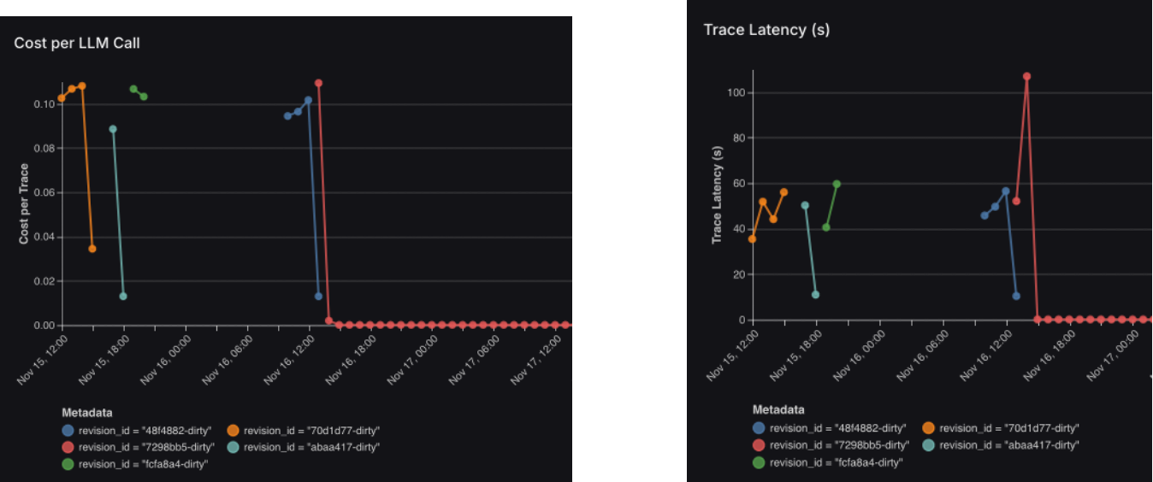
APPENDIX T: Model Evaluation - LLM Performance Metrics
Using OpenAI GPT 4 as the underlying model:
Average cost per LLM call: $0.15 USD ($0.21 CAD) per safety plan generated
Average latency: 60 seconds to generate (due to chain-of-thought with two steps of LLM ”thinking” and providing response)

Slide 38
APPENDIX U: Model Evaluation & Limitations (Expanded)
Metric Evaluation | Model Limitations | Responsible AI Strategies
Evaluation Focus on Generated Safety Plan: Information Retrieval (Context Precision and Recall) Quality of LLM Output: Faithfulness (ie. factual Accuracy), and Answer Relevancy (does the safety plan address user safety concerns?) Human-in-the-loop Evaluations: Validating scores, checking quality of output and common issue Prompt engineering improvements in the 2nd iteration improved Context Recall, with minimal changes to Context Precision and Answer Relevancy. Faithfulness dropped slightly by 6%, highlighting the trade-off between retrieval breadth and factual accuracy. | Coverage Gaps: Knowledge limited to documents provided from Toronto Police, City of Toronto, TTC. Quality of responses and retrieved documents will depend on corpus. Trade-off –Context Precision & Recall: Balance between coverage of recommendations (Recall) and trust/accuracy (Precision). Priority is precision; this is ideal for safety-critical, trust-sensitive applications like public safety, with trade-off being specific information missed in documents. Cost: It cost $0.21 CAD for survey creation + safety plan generation, with latency of ~1 minute. Future iterations could mitigate this high cost by adopting open-source LLMs or optimizing retrieval strategies, or the trend as LLM API tokens become cheaper. LLM Hallucinations and unexpected behaviors: Hallucinations occurred when the LLM struggled with neighborhood-specific facts, leading to generic or irrelevant advice. Enhanced prompts and retrieval constraints reduced these issues, with future iterations focusing on expert-reviewed documents and refined LLM parameters. | Credible Sources: Leveraged sources, such as City of Toronto, Canadian Government, TTC, City of Toronto, to build the corpus, who provided trusted and practical information. Output Transparency: Safety Plan will always display the 5 sources used; users may trace back where the information came from. LLM Guardrails: For both front and back-end, LLM guardrails include pre-defined templates and specific instructions (i.e. stay within advisory roles) for critical crime types, and temperature adjustments, to minimize hallucinations. Initial survey question inputs are selective multiple-choice answers, to avoid abuse or prompt injection attacks. Bias Mitigation: Human in the Loop evaluation of safety plans, ensuring LLM generated safety plan focus on actionable items without speculations of neighbourhood or demographic.

Slide 39
APPENDIX V: Sample User Feedback Survey (SixSafety)
Canadian Policing - Performance Framework Dimension (from Appendix B) | Possible Survey Questions | Importance to TPS
Crime and Victimization | How useful do you find the final safety recommendations? On a scale from 1-5, how would you rate the effectiveness of the recommendations in improving your personal safety? | Highlight if tool is effectively support TPS crime prevention strategies, and usefulness of the TPS crime prevention articles/documents.
Police Activities and Deployment | How satisfied are you with the overall response time and relevance of information provided? Do you think this tool connects your community with policing efforts? Why or why not? | Evaluate TPS’ ability to deliver timely and accurate information in digital tools Assess against benchmarks for community engagement goals
Police Resources | Would you recommend this tool to others in your community? On a scale from 1-5, how likely are you to leverage this tool and other online tools from TPS to assist with safety planning? | Pulse-check regading if TPS initiatives are being adopted, along with other initiatives, with community
Trust & Confidence in Police | On a scale from 1-5, how confident are you regarding the effectiveness of the recommendations provided by Toronto Police Service resources, in the app? | Reflects community trust in TPS’s expertise and the credibility of its safety solutions
Suggestions for Data Collection & Methodology: Ensure data collection from various and diverse backgrounds to avoid class imbalance, working with 3rd party research firms to accomplish this; benchmark by conducting surveys at a semi-regular basis, such as annually, and consider benchmarking against neighbourhoods with higher rates of adoption of SixSafety; consider including along with SixSafety Pilot on the web application

